Slide 1
Ethical Student Hackers
Open Source Intelligence (OSINT)

Slide 2
The Legal Bit
The skills taught in these sessions allow identification and exploitation of security vulnerabilities in systems. We strive to give you a place to practice legally, and can point you to other places to practice. These skills should not be used on systems where you do not have explicit permission from the owner of the system. It is VERY easy to end up in breach of relevant laws, and we can accept no responsibility for anything you do with the skills learnt here.
If we have reason to believe that you are utilising these skills against systems where you are not authorised you will be banned from our events, and if necessary the relevant authorities will be alerted.
Remember, if you have any doubts as to if something is legal or authorised, just don't do it until you are able to confirm you are allowed to.
Notes:
Nick

Slide 3
Code of Conduct
Before proceeding past this point you must read and agree to our Code of Conduct - this is a requirement from the University for us to operate as a society.
If you have any doubts or need anything clarified, please ask a member of the committee.
Breaching the Code of Conduct = immediate ejection and further consequences.
Code of Conduct can be found at https://shefesh.com/downloads/SESH%20Code%20of%20Conduct.pdf
Notes:
Nick

Slide 4

OSINT - What is it?
Open Source Intelligence - collecting information about a person or group that is free for anyone to access on the internet (public twitters, blog posts, uploaded pictures) or otherwise (publications, phone books)
Uses
Cyber criminals
Cybersecurity defense
Marketing

Slide 5
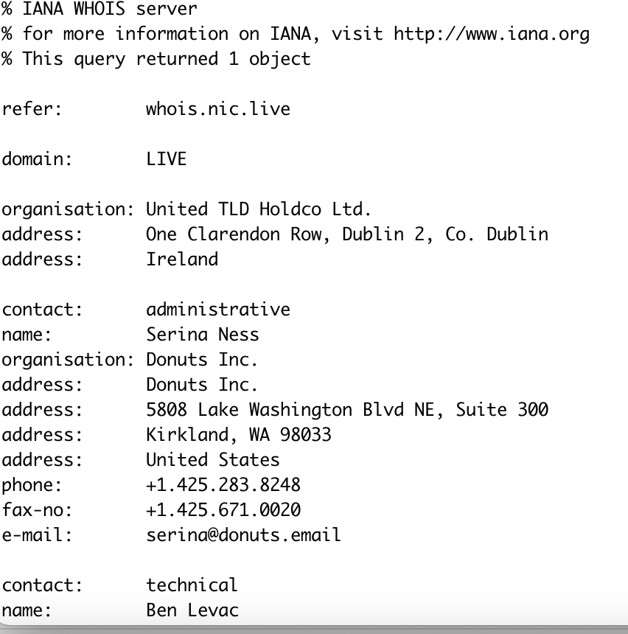
Online Presence
Image Locations
Jeffrey's Image Metadata Viewer
Reverse Image Search
Habits and associations
Fb-sleep-stats
Location when you post
Private info eg Tony Abbott’s boarding pass
Usernames can be tracked
IP Address
Location
WHOIS
ExoneraTor
Notes:
http://exif.regex.info/exif.cgi
onemilliontweetmap.com

Slide 6
Online Presence
Criminal records
Vehicles
Gaming platforms
Reverse phone lookup
Wayback Machine
Search Facebook uses based on school, interested in , etc. (https://searchisback.com/)
https://spoonbill.io/ (tracks twitter profile changes)
Wordpress or Blogger
Advanced Twitter search
Google Maps

Slide 7
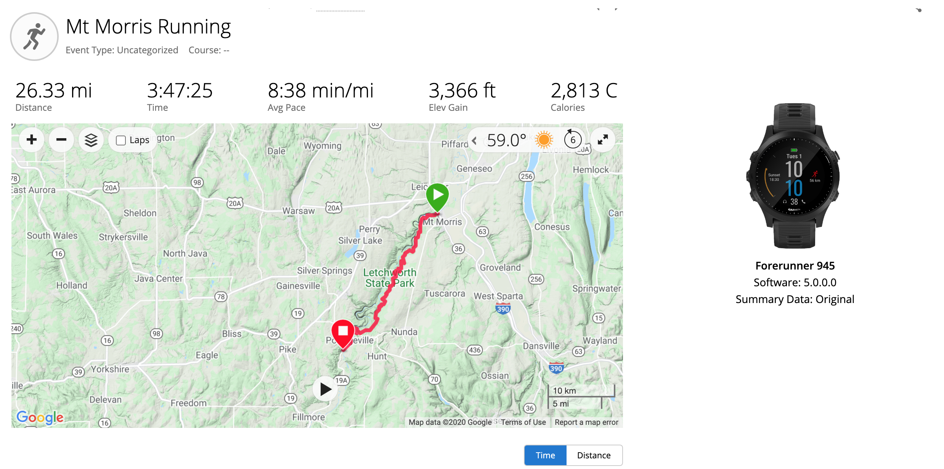
Garmin and Relive
By making information shareable via public links the data becomes available to anyone who knows how to search it.
Relive
- share a map of your travels
Garmin
Can see people's activities
May reveal home location if they start running there

Slide 8

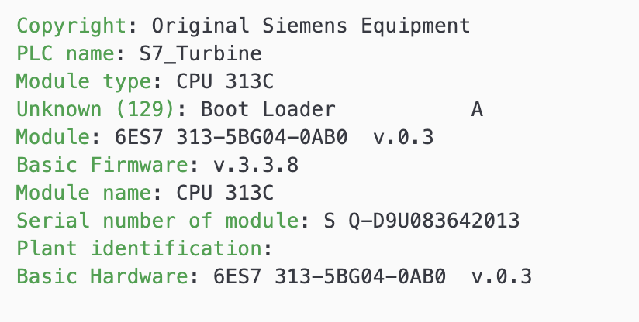
Shodan
the world's first search engine for Internet-connected devices
Works by randomly finding IPs and testing a random port
Used by defenders to understand what's publically available
Shodan interacts with only services running on the devices
Helps identify vulnerable services

Slide 9

Maltego
On kali
Gathers data on an entities and graphically represents its relationships
Run functions on entities
Create your own
Example Functions
Facebook search , Facebook friends
whois lookup
DNS lookup

Slide 10
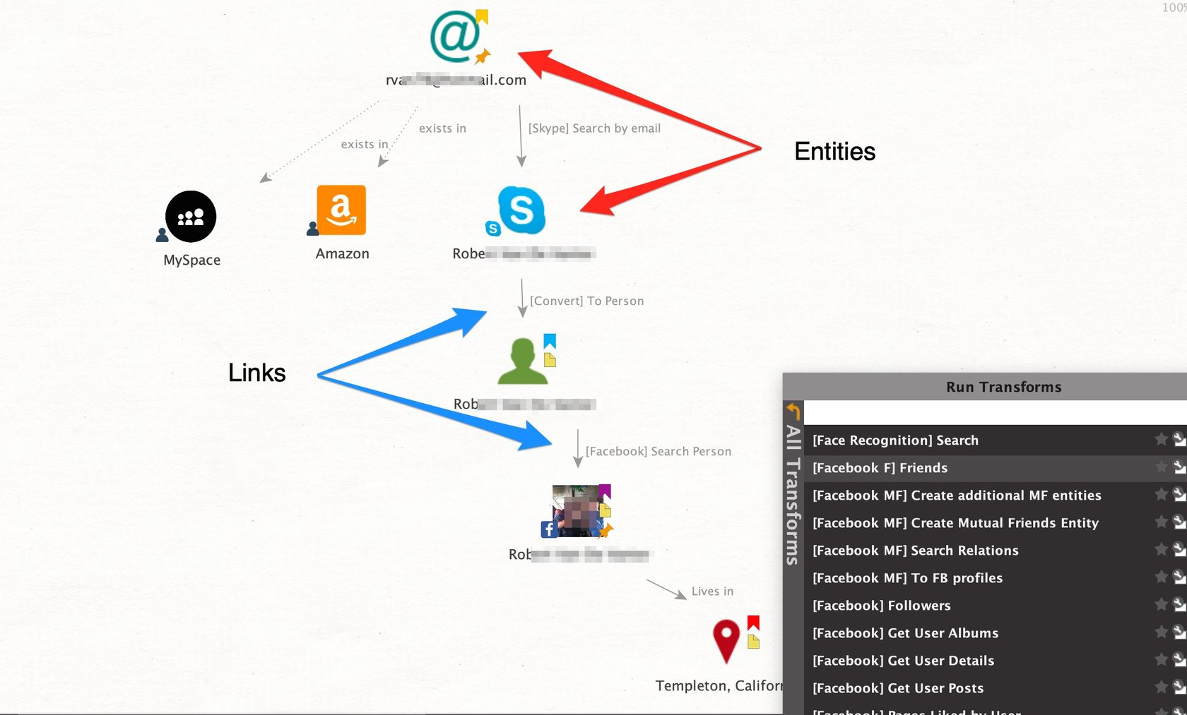

Slide 11

Google Dorks
Taking advantage of advanced search features on google to find vulnerables indexed websites.
Examples:
Intitle:’login’
filetype:’.mp4’
Find .env files, password files, etc.
List of commands of exploit db
intitle:index.of jpg
Finds sites image directories
DON’T BREAK THE LAW

Slide 12
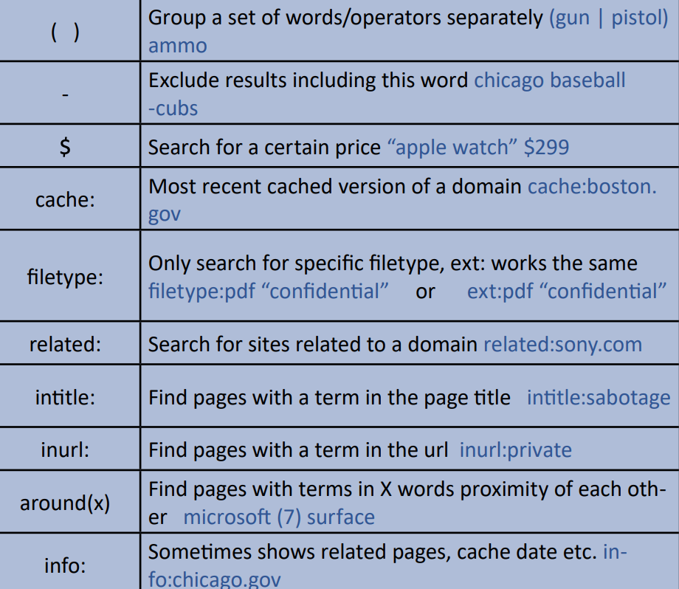

Slide 13

To Find Out More:
Week In OSINT Blog: sector035.nl
OSINT Cheatsheets
Bellingcat, online news and guides
https://www.bellingcat.com/category/resources/how-tos/?fwp_tags=osint

Slide 14
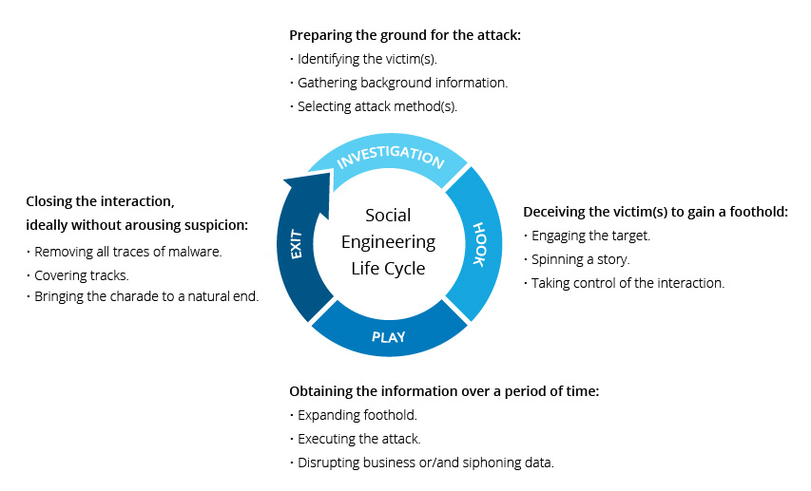
Social Engineering
Tricking someone into divulging information or taking action, usually through technology
Take advantage of a potential victim's natural tendencies and emotional reactions.
Notes:
Social engineering take more than one step
A perpetrator first investigates the intended victim to gather necessary background information, such as potential points of entry and weak security protocols, needed to proceed with the attack.
Then, the attacker moves to gain the victim’s trust and provide stimuli for subsequent actions that break security practices, such as revealing sensitive information or granting access to critical resources.

Slide 15

Baiting / Quid Pro Quo
Someone at Microsoft said the weakest link in cybersecurity is human
Baiting
Promises an item or good to entice victims
Can be free music, movie download, torrent files
Also can be physical exploiting human curiosity
USB stick in the bathroom, office floor or lift
Quid Pro Quo
Similar to baiting, but it promises services
Impersonate to be an IT consultant or customer support trying to get credentials of victims
It can take a form of survey
Notes:
Social engineering steps take more than one step
Quid pro quo -- surprisingly ppl are willing to give out infromation
If its survey and asks you this is about cybersecurity, which kind of information ppl use when they create a password. Please tell me the category you fit
family/pets name/ anniversary…

Slide 16

Pretexting / Vishing / Tailgating
Pretexting
Preys on human’s desire to trust
Requires a lot of research on the part of a scammer to make it plausible for the victim to believe
Pretends to be an employee from another branch, an auditor, or a new employee
Vishing
Same as phishing but over the phone
Tailgating
Used to gain access to a secure building by blending in
Notes:
Vishing, such as someone calling you that ‘ I heard that you are a victim for a car incident…..’
Tailgating, imagine someone who has so many stuffs in his/her hand to get the badge out, in front of the building
You are likely to scan your badge to open the door to help

Slide 17
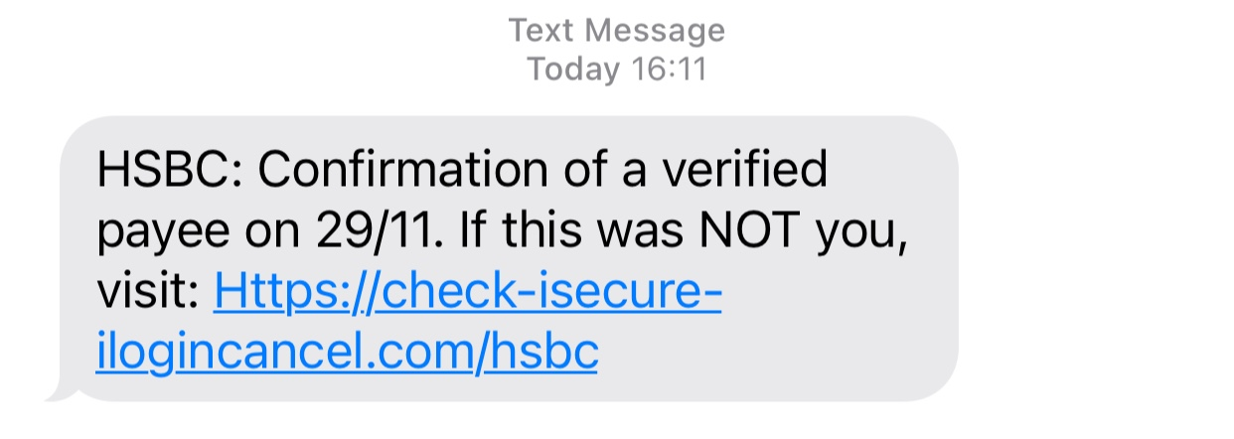
Phishing
The most common social engineering technique
Obtain personal information such as names, addresses and Social Security Numbers.
Use shortened or misleading links that redirect users to suspicious websites that host phishing landing pages.
Incorporate threats, fear and a sense of urgency in an attempt to manipulate the user into responding quickly.
Notes:
Uses email, text mostly

Slide 18
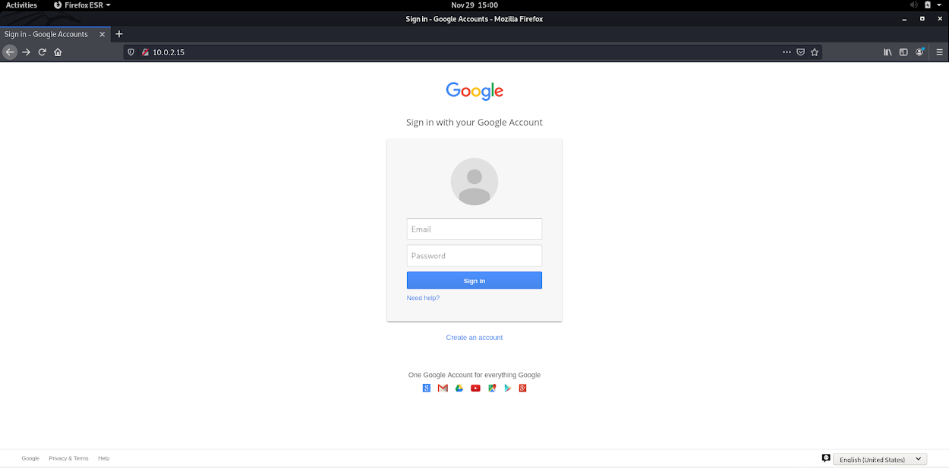
Credential Harvester Attack

Slide 19
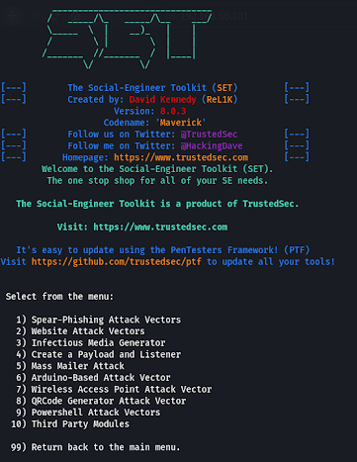
Social Engineering Toolkit (SET)
Open source python tool aimed at penetration testing around social engineering
Installed on kali, can be installed on Linux and Mac machines
https://github.com/trustedsec/social-engineer-toolkit
Notes:
SET or social engineering toolkit is an open-source and free-ware penetration testing tool for social engineering and custom attacks. Social engineering toolkit has several custom attack vectors that can help in making a successful attack in no time. It is very fast and has two main types of attacks. Social engineering attacks and penetration testing or fast-track attacks. It can be started directly from the terminal window using the following command.

Slide 20
msfpc
Tools that generate various payloads based on user-specific options
Automate the processes involved in working with Metasploit and msfvenom
Instructions with msfpc -h
Automatically generate a Windows reverse Meterpreter payload, using the IP address of the eth0 interface as the LHOST parameter.
msfpc windows eth0
Semi-interactively create a Windows Meterpreter bind shell on port 5555.
msfpc windows bind 5555 verbose
msfpc linux
msfpc apk
Notes:
Payload, in simple terms, are simple scripts that the hackers utilize to interact with a hacked system. Using payloads, they can transfer data to a victim system.
MSFPC is a package that contains several tools that generate various payloads based on user-specific options. It is also called MSFvenom payload creator, and its goal is to automate the processes involved in working with Metasploit and msfvenom. Msfpc help command can be launched using the following console as follows.
when it comes to creating basic payloads quickly. The main drawback to this script is that it really only works for basic payloads. You aren't going to get any encoding to bypass antivirus, but depending on your targets, this may not matter. Sometimes, you just need to create a quick payload, drop it somewhere, and call it a day. In this scenario, msfpc.sh really shines.

Slide 21
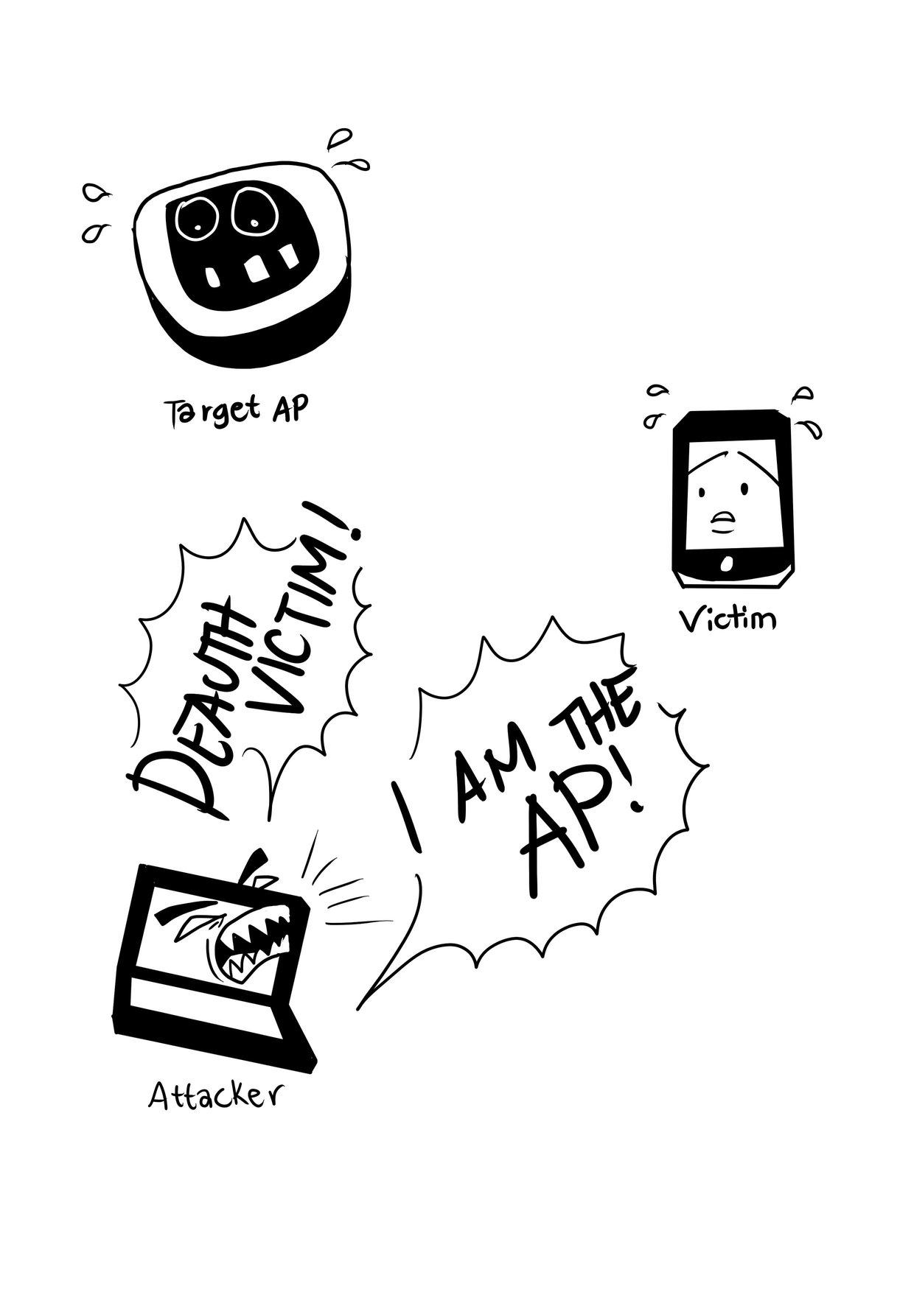
Wifiphisher
Need USB WiFi Adapter to use this tool… :(
Achieve a man-in-the-middle position against wireless clients by performing targeted Wi-Fi association attacks
Mount victim-customized web phishing attacks against the connected clients in order to capture credentials (e.g. from third party login pages or WPA/WPA2 Pre-Shared Keys)
Infect the victim stations with malwares.
Uses a number of techniques to obtain a man-in-the-middle position
Evil Twin
KARMA
Beacons
https://github.com/wifiphisher/wifiphisher
Notes:
It is a unique social engineering tool that configures an automated phishing attack on Wi-Fi internetworks to get the credentials of a target user with the help of Malware. This social engineering attack tool gets WPA/WPA2 passwords and doesn’t perform brute force attacks for finding passwords. It is done with the help of a man-in-the-middle attack with the addition of the evil twin attack.
It is performed in 3 main steps which are stated below:
The target device becomes unauthenticated from their access points.
Wifiphisher creates a rogue AP for the target device and copies all the information.
The target device is taken to a realistic page which contains the phishing page disguised.
Evil Twin, where Wifiphisher creates a fake wireless network that looks similar to a legitimate network.
KARMA, where Wifiphisher masquerades as a public network searched for by nearby Wi-Fi clients.
Known Beacons, where Wifiphisher broadcasts a dictionary of common ESSIDs, that the around wireless stations have likely connected to in the past

Slide 22
OSINT CTF
-> Use techniques covered together to find out about someone in the opposite group

Slide 23
Upcoming Sessions
30th Nov – OSINT
7th Dec – Hack the Box
14th Dec – Xmas Session
What’s up next?
www.shefesh.com/sessions

Slide 24

Any Questions?
www.shefesh.com

